Slide 1
Uninformed Search

Slide 2
Measuring problem-solving performance
Completeness: Is the algorithm guaranteed to find a solution when there is one?
Optimality: Does the strategy find the optimal solution, as defined on page 68?
Time complexity: How long does it take to find a solution?
Space complexity: How much memory is needed to perform the search?

Slide 3
Uninformed search strategies
Uninformed: While searching you have no clue whether one non-goal state is better than any other. Your search is blind.
Various blind strategies:
Breadth-first search
Uniform-cost search
Depth-first search
Iterative deepening search

Slide 4
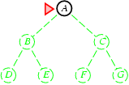
Breadth-first search
Expand shallowest unexpanded node
Implementation:
fringe is a first-in-first-out (FIFO) queue, i.e., new successors go at end of the queue.
Is A a goal state?

Slide 5
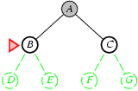
Breadth-first search
Expand shallowest unexpanded node
Implementation:
fringe is a FIFO queue, i.e., new successors go at end
Expand:
fringe = [B,C]
Is B a goal state?

Slide 6
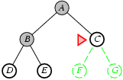
Breadth-first search
Expand shallowest unexpanded node
Implementation:
fringe is a FIFO queue, i.e., new successors go at end
Expand:
fringe=[C,D,E]
Is C a goal state?

Slide 7
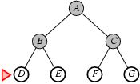
Breadth-first search
Expand shallowest unexpanded node
Implementation:
fringe is a FIFO queue, i.e., new successors go at end
Expand:
fringe=[D,E,F,G]
Is D a goal state?

Slide 8
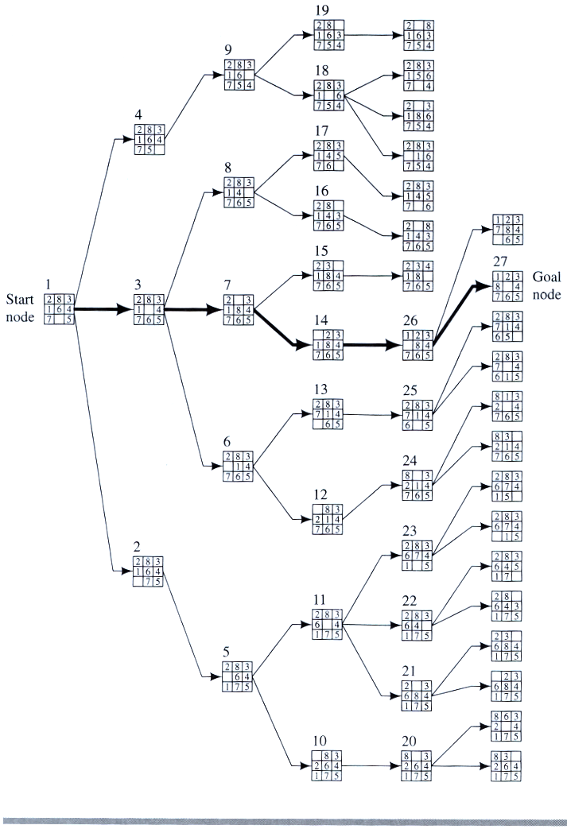
Example
BFS

Slide 9
Properties of breadth-first search
Complete? Yes it always reaches goal (if b is finite)
Time? 1+b+b²+b³+… +b^{d} + (b^{d+1}-b)) = O(b^{d+1})
(this is the number of nodes we generate)
Space? O(b^{d+1}) (keeps every node in memory,
either in fringe or on a path to fringe).
Optimal? Yes (if we guarantee that deeper solutions are less optimal, e.g. step-cost=1).
Space is the bigger problem (more than time)

Slide 10
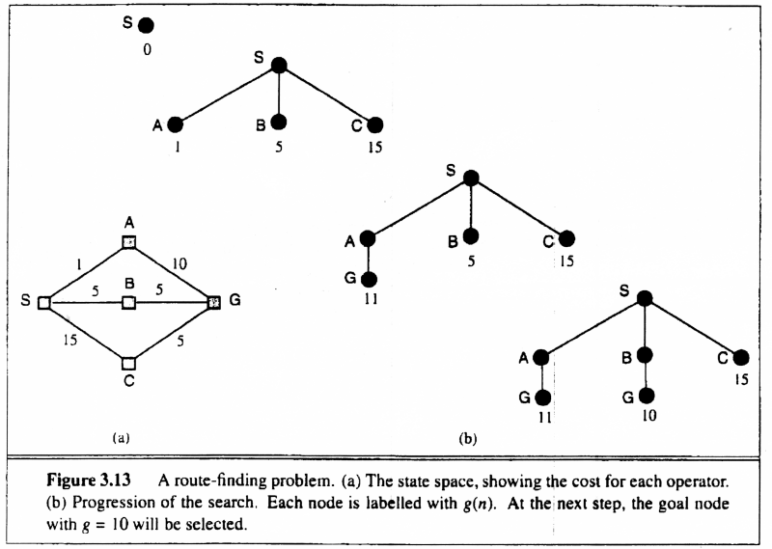
Uniform-cost search
Breadth-first is only optimal if step costs is increasing with depth (e.g. constant). Can we guarantee optimality for any step cost?
Uniform-cost Search: Expand node with
smallest path cost g(n).

Slide 11
Uniform-cost search
Implementation: fringe = queue ordered by path cost
Equivalent to breadth-first if all step costs all equal.
Complete? Yes, if step cost ≥ ε
(otherwise it can get stuck in infinite loops)
Time? # of nodes with path cost ≤ cost of optimal solution.
Space? # of nodes on paths with path cost ≤ cost of optimal
solution.
Optimal? Yes, for any step cost.

Slide 12
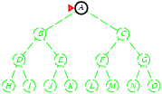
Depth-first search
Expand deepest unexpanded node
Implementation:
fringe = Last In First Out (LIPO) queue, i.e., put successors at front
Is A a goal state?

Slide 13
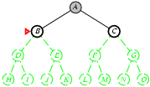
Depth-first search
Expand deepest unexpanded node
Implementation:
fringe = LIFO queue, i.e., put successors at front
queue=[B,C]
Is B a goal state?

Slide 14
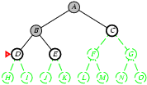
Depth-first search
Expand deepest unexpanded node
Implementation:
fringe = LIFO queue, i.e., put successors at front
queue=[D,E,C]
Is D = goal state?

Slide 15
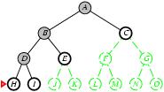
Depth-first search
Expand deepest unexpanded node
Implementation:
fringe = LIFO queue, i.e., put successors at front
queue=[H,I,E,C]
Is H = goal state?

Slide 16
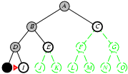
Depth-first search
Expand deepest unexpanded node
Implementation:
fringe = LIFO queue, i.e., put successors at front
queue=[I,E,C]
Is I = goal state?

Slide 17
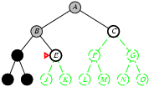
Depth-first search
Expand deepest unexpanded node
Implementation:
fringe = LIFO queue, i.e., put successors at front
queue=[E,C]
Is E = goal state?

Slide 18
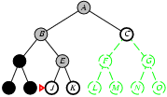
Depth-first search
Expand deepest unexpanded node
Implementation:
fringe = LIFO queue, i.e., put successors at front
queue=[J,K,C]
Is J = goal state?

Slide 19
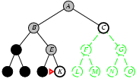
Depth-first search
Expand deepest unexpanded node
Implementation:
fringe = LIFO queue, i.e., put successors at front
queue=[K,C]
Is K = goal state?

Slide 20
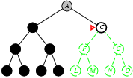
Depth-first search
Expand deepest unexpanded node
Implementation:
fringe = LIFO queue, i.e., put successors at front
queue=[C]
Is C = goal state?

Slide 21
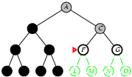
Depth-first search
Expand deepest unexpanded node
Implementation:
fringe = LIFO queue, i.e., put successors at front
queue=[F,G]
Is F = goal state?

Slide 22
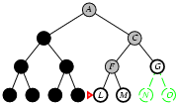
Depth-first search
Expand deepest unexpanded node
Implementation:
fringe = LIFO queue, i.e., put successors at front
queue=[L,M,G]
Is L = goal state?

Slide 23
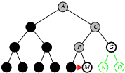
Depth-first search
Expand deepest unexpanded node
Implementation:
fringe = LIFO queue, i.e., put successors at front
queue=[M,G]
Is M = goal state?

Slide 24
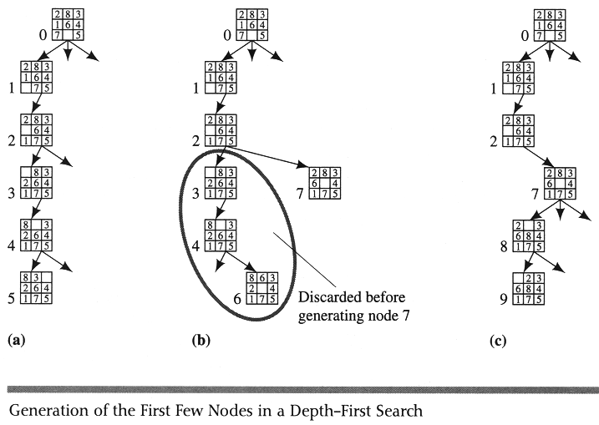
Example DFS

Slide 25
Properties of depth-first search
Complete? No: fails in infinite-depth spaces
Can modify to avoid repeated states along path
Time? O(b^{m}) with m=maximum depth
terrible if m is much larger than d
but if solutions are dense, may be much faster than
breadth-first
Space? O(bm), i.e., linear space! (we only need to
remember a single path + expanded unexplored nodes)
Optimal? No (It may find a non-optimal goal first)

Slide 26
Iterative deepening search
To avoid the infinite depth problem of DFS, we can
decide to only search until depth L, i.e. we don’t expand beyond depth L.
→ Depth-Limited Search
What of solution is deeper than L? → Increase L iteratively.
→ Iterative Deepening Search
As we shall see: this inherits the memory advantage of Depth-First
search.

Slide 27
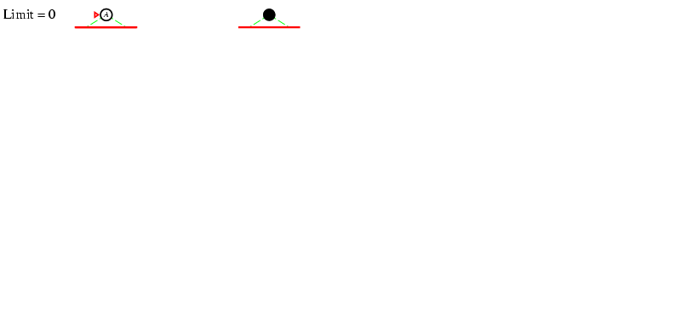
Iterative deepening search L=0

Slide 28
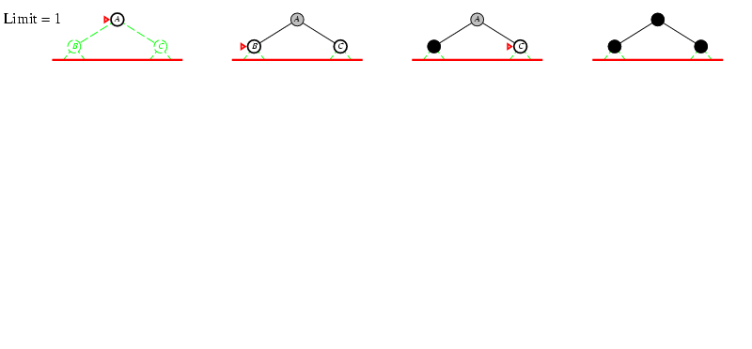
Iterative deepening search L=1

Slide 29
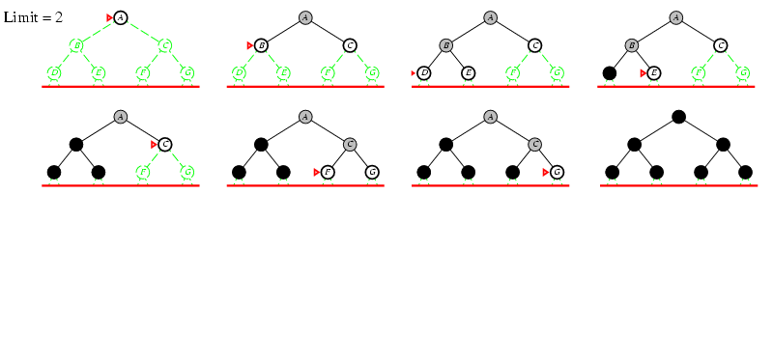
Iterative deepening search lL=2

Slide 30
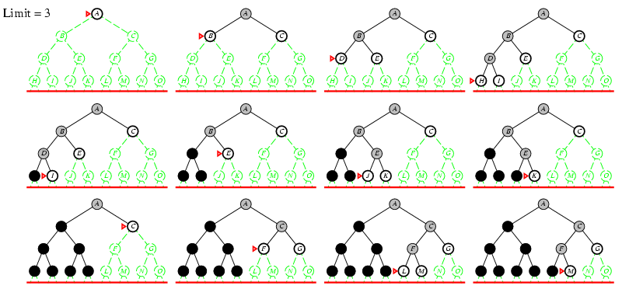
Iterative deepening search lL=3

Slide 31
Iterative deepening search
Number of nodes generated in a depth-limited search to depth d with branching factor b:
N_{DLS} = b⁰ + b¹ + b² + … + b^{d-2} + b^{d-1} + b^{d}
Number of nodes generated in an iterative deepening search to depth d with branching factor b:
N_{IDS} = (d+1)b⁰ + d b¹ + (d-1)b² + … + 3b^{d-2} +2b^{d-1} + 1b^{d} =
For b = 10, d = 5,
N_{DLS} = 1 + 10 + 100 + 1,000 + 10,000 + 100,000 = 111,111
N_{IDS} = 6 + 50 + 400 + 3,000 + 20,000 + 100,000 = 123,450
NBFS = ............................................................................................ = 1,111,100
BFS

Slide 32
Properties of iterative deepening search
Complete? Yes
Time? (d+1)b⁰ + d b¹ + (d-1)b² + … + b^{d} = O(b^{d})
Space? O(bd)
Optimal? Yes, if step cost = 1 or increasing function of depth.

Slide 33
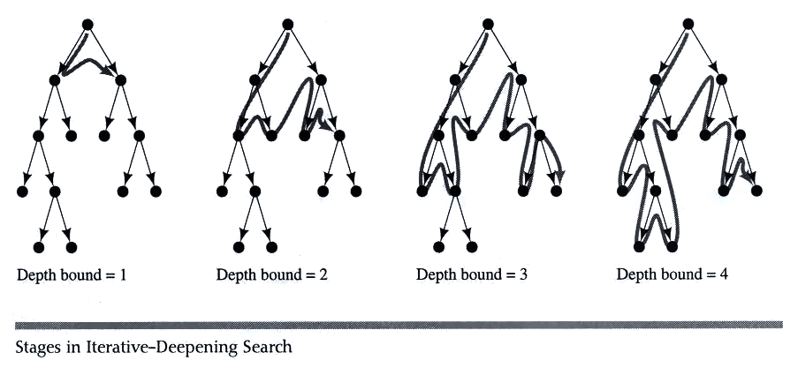
Example IDS

Slide 34
Bidirectional Search
Idea
simultaneously search forward from S and backwards from G
stop when both “meet in the middle”
need to keep track of the intersection of 2 open sets of nodes
What does searching backwards from G mean
need a way to specify the predecessors of G
this can be difficult,
e.g., predecessors of checkmate in chess?
what if there are multiple goal states?
what if there is only a goal test, no explicit list?

Slide 35
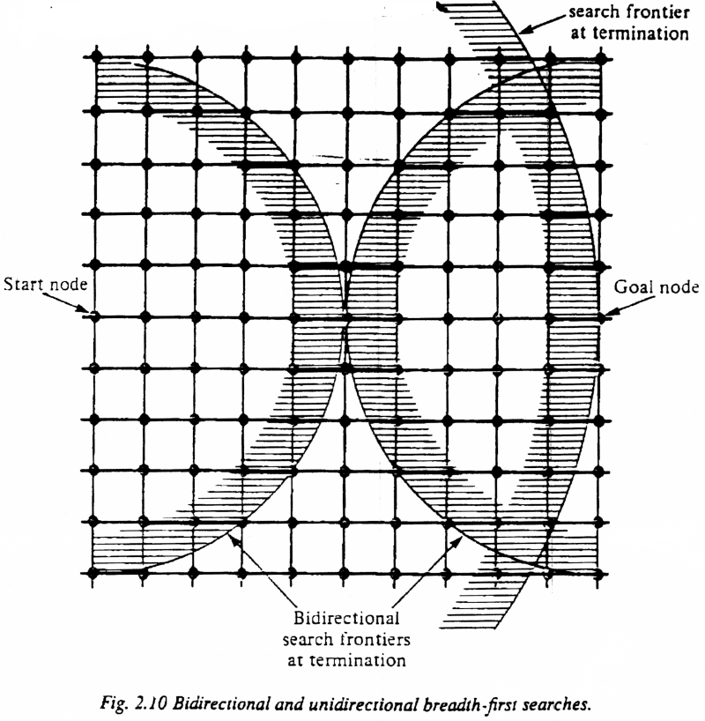
Bi-Directional Search
Complexity: time and space complexity are:

Slide 36
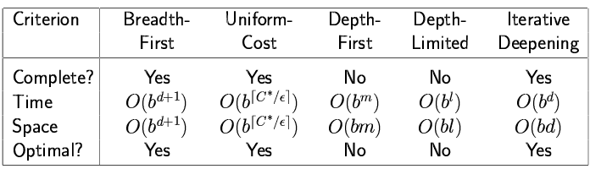
Summary of algorithms

Slide 37
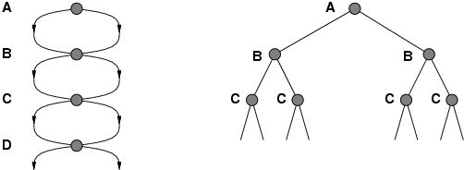
Repeated states
Failure to detect repeated states can turn a linear problem into an exponential one!

Slide 38
Solutions to Repeated States
S
B
S
B
C
C
C
S
B
S
State Space
Example of a Search Tree
Method 1
do not create paths containing cycles (loops)
Method 2
never generate a state generated before
must keep track of all possible states (uses a lot of memory)
e.g., 8-puzzle problem, we have 9! = 362,880 states
suboptimal but practical
optimal but memory inefficient

Slide 39
Summary
Problem formulation usually requires abstracting away real-world details to define a state space that can feasibly be explored
Variety of uninformed search strategies
Iterative deepening search uses only linear space and not much more time than other uninformed algorithms
http://www.cs.rmit.edu.au/AI-Search/Product/
http://aima.cs.berkeley.edu/demos.html (for more demos)

